Slide 1

基于Microsoft Teams 构建应用集成和工作流 陈 希章 | 微软（亚洲）互联网工程院
实施 Microsoft 身份（一）
实施 Microsoft 身份（二）
Microsoft Graph 简介
扩展 Microsoft SharePoint
扩展 Microsoft Teams (一）
扩展 Microsoft Teams (二）

Slide 2
扩展 Microsoft Teams – 第 1 部分（共 2 部分）
为 Microsoft Teams 构建应用概述
消息传递扩展
选项卡
对话机器人
任务模块

Slide 3
为 Microsoft Teams 构建应用概述
什么是 Microsoft Teams 应用？
如何为 Microsoft Teams 创建应用？
什么时候应该选择构建自定义 Microsoft Teams 应用？
Notes:
Microsoft Teams is an extensible platform you can build custom apps on. Understand what is possible with a Microsoft Teams custom app, and determine if it's right for you.

Slide 4
什么是 Microsoft Teams 应用？

Slide 5


Microsoft Teams 应用能做什么?
在 Teams 平台上构建的应用主要侧重于提高协作和改善工作效率。
允许在外部项目上进行协作。
从对话中触发工作流。
将重要事件通知你的团队。
嵌入其他站点/服务的功能。

Slide 6
什么是 Microsoft Teams 应用？
Microsoft Teams 应用包括三个主要组成部分：
Microsoft Teams 客户端（网页、桌面或移动）提供了用户将与互动的扩展点和 UI 元素
Teams 应用包创建用户安装的应用
清单文件
图标
由开发人员托管的 Web 服务提供了为提供支持应用的 API 和逻辑
Notes:
- A Teams app manifest is a text file that contains the metadata required to present an app to users. Manifests define the user experience.
- Note that the Microsoft Teams Platform is not a hosting service; the web services powering your app must be hosted by you and accessible by HTTPS over the internet.
- It is also important to keep in mind that any functionality you expose in a Microsoft Teams app is publicly available over the internet unless you take additional steps to secure it. If you are providing access to confidential or protected information you'll want make sure your services are at a minimum authenticating the endpoint connecting to your app, or authenticating your users.

Slide 7
Teams 客户端可以扩展到哪里？
Microsoft Teams 客户端中有多个位置可以扩展，以支持用户与该应用互动。
Teams 应用功能:
选项卡
消息传递扩展
对话机器人
Webhooks 和连接器
Teams 应用上下文：
团队、通道和群聊
个人应用
消息
Notes:
Depending on your scenario you may choose to focus on a single extension point or combine multiple.
- Teams, channels and group chats can be extended with conversational bots, configurable tabs, webhooks and connectors.
- Personal apps can be extended with conversational bots and personal tabs
- Messaging extensions allow users to interact with your web service through buttons and forms from the compose message area, the command box, or directly from a message. Your app can respond by presenting a form to the user to collect more information, sending a reply to the original message, or sending a message directly to the user.

Slide 8
如何为 Microsoft Teams 创建应用？

Slide 9
设计应用
要为 Microsoft Teams 创建一个成功的应用，最重要的一步是选择合适的扩展点与 UI 元素的组合。
消息传递扩展 – 搜索命令可用于允许你的用户搜索外部系统，然后在 Teams 内分享搜索结果。 通过卡片和卡片操作，你可以为该搜索的结果选择丰富的格式，并允许用户在不离开 Microsoft Teams 客户端的情况下对结果执行操作。
消息传递扩展 – 操作命令非常适合在一个位置收集用户的信息，然后将这些信息发送到你的 Web 服务。 如果你需要创建某种记录，或在单个事务中收集多条信息，则这些命令非常有用。
选项卡 – 在组和通道中提供共享画布，供多人进行协作。 如果你有适用于一组人员的信息或服务，则应将其添加到你的应用中。 请记住，每个人都在同一个画布上工作，你的页面应该是无状态的，并作为单页面应用运行。
选项卡 – 在个人应用中可以实现类似于个人网络的体验。 它们通常最适合于“中心”场景 -“分配给我的项目”，或“我创造的东西”。 它们对静态内容也很有用，如帮助或关于页面。
对话机器人 – 在分组和通道中帮助向对话中添加其他信息，这对每个人（或至少大多数人）都有用。 它们可以用来主动向对话中添加相关信息，或回应用户的请求（"嘿，机器人，为我们应该去哪里吃午饭创建一个投票"）。 通常情况下，它们不应该用于多向对话 - 使用任务模块来收集信息，或将对话转移到一对一的聊天中，然后将结果插入到原始对话中。
对话机器人 – 在个人应用中可以支持种类繁多的工作负载。 问答机器人、在其他系统中启动工作流的机器人、讲笑话的机器人和做笔记的机器人只是少数几个例子。 只需记住考虑基于对话的界面是否是呈现功能的最佳方式。
Webhooks 和连接器用于允许用户订阅通道，以获得来自外部系统的通知消息。
Notes:
The most important step in creating a successful app for Microsoft Teams is choosing the right combination extensibility points and UI elements to take advantage of. You should spend a good deal of time understanding the problem you're trying to solve with your app and mapping your solution across the various ways users can interact with your app in the Microsoft Teams client. Don't underestimate the importance of context and scope! A conversational bot that works well in a one-to-one chat may not work at all as part of a group chat or channel conversation.
Here's a recap of what's available for you, and some scenarios they're best suited for. You can accomplish many tasks in more than one way; choosing the right tool for the job will make for a much better user experience.
Messaging Extensions - search commands are useful for allowing your users to search an external system and then share the results of that search within Teams. With cards and card actions, you can richly format the results of that search, and allow users to do actions on the result without leaving the Microsoft Teams client.
Messaging Extensions - action commands are great for collecting information from your user in a single place, then sending that information to your web services. They excel in scenarios where you need to create a record of some kind, or collect more than a few pieces of information as part of a single transaction.
Tabs - in groups and channels provide a shared canvas for multiple people to collaborate. You should add this to your app if you've got information or services that are applicable to a group of people. Keep in mind that everyone is working from the same canvas, your page should be stateless and operate as a single-page app.
Tabs - in personal apps allow for a personal web-like experience. They're typically best for "hub" scenarios - "items assigned to me", or "things I've created". They can also be useful for static content like help or about pages.
Conversational bots - in groups and channels help add additional information to a conversation that is useful for everyone (or at least most) involved. They can be used to proactively add relevant information to the conversation, or respond to user requests ("hey bot, create a poll for where we should go to lunch"). Typically they shouldn't be used for multi-turn conversations - use a task module to collect the information or move the conversation to a one-to-one chat instead, then insert the results back into the original conversation.
Conversational bots - in personal apps can enable incredibly diverse workloads. Q&A bots, bots that start workflows in other systems, bots that tell jokes and bots that take notes are just a few examples. Just remember to consider if a conversation-based interface is the best way to present your functionality.
Webhooks & Connectors are useful to allow users to subscribe a channel to notification messages from an external system.
The best apps will typically take advantage of more than one extension point. For example, let's say your organization wants to allow people to submit suggestions for improvements. You could create an app with a messaging extension search command to find and share existing suggestions, add an action command to allow users to create and update suggestions, a channel tab so a team can see all suggestions assigned to them, and a personal tab so a user can see all the suggestions they've submitted in the past. Add a conversational bot powered by natural language processing and machine learning allowing users to do complex queries across the suggestions and you've got a fully featured, fully integrated Teams app!

Slide 10
为 Microsoft Teams 开发应用的工具
开发人员可以使用多种工具来支持 Microsoft Teams 应用的开发。
设置和配置 Teams 应用的工具：
适用于 Microsoft Teams 的 Yeoman 生成器
App Studio
用于 Visual Studio Code 或 Visual Studio IDE 的 Microsoft Teams Toolkit
用于构建 Web 服务的工具
– 用于消息传递扩展和对话式机器人的 Bot Framework SDK
– 用于选项卡和其他内容页面的 Teams JavaScript 客户端 SDK
– 用于在 Node.js 中构建应用的 Yeoman 生成器
– 一套用于 Web 内容页面的开放源码控件 (Fluent UI)。
– 可供生产的应用模板

Slide 11
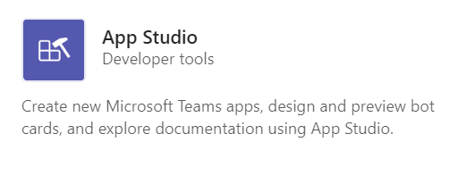
用于 Microsoft Teams 应用开发的 App Studio
App Studio 可简化为 Teams 应用创建清单和程序包的过程。
可以使用 App Studio：
创建和编辑应用清单
设计和预览卡片
查找文档
访问 React 控件库中的 UI 控件
Notes:
You can find and install App Studio in the Teams store.
Lab will cover how to configure an app manifest using App Studio.
The React control library will be deprecated in the future. Consider using the Fluent-UI react controls as an alternative (formerly Stardust UI).

Slide 12
用于分发 Teams 应用的选项
有三种分发 Microsoft Teams 应用的选项:
直接共享应用包。
将应用发布到组织应用目录
将应用发布到公共 App Store
Microsoft Teams 中的所有应用安装都是特定于上下文的
Notes:
- Sharing the app package directly is useful when the app is directed towards a limited audience.
- If the app is applicable to a specific organization, a tenant administrator can upload the app to the organization’s app catalog.
If the app is intended for all Teams users, the app can be submitted for publication in the public app store. This involves a review process.
Because all app installations in Teams are context-specific, the entirety of an app may not always be installed for all users.
Each organization has complete control over determining which apps will be uploaded to their organizational app catalog, and which apps are available to install from the app store.

Slide 13
以任务为导向的互动与消息传递扩展
消息传递扩展概述
操作指令消息传递扩展
搜索指令的消息传递扩展
链接展开消息扩展
Notes:
In this section, you’ll learn how to create different types of messaging extensions in a custom Microsoft Teams app.

Slide 14
消息传递扩展概述

Slide 15
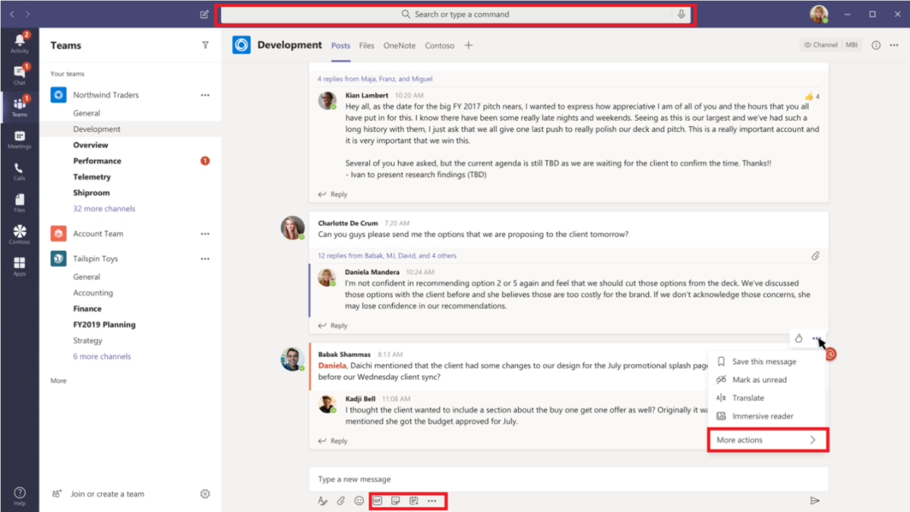
什么是消息传递扩展？
消息传递扩展允许用户向你的服务查询信息（搜索），并向你的服务发布信息（操作）。
开发人员可以将交互的结果送回 Microsoft Teams 的客户端，通常是以格式丰富的卡片形式。
用户可以从以下方面调用消息传递扩展:
命令/搜索栏
编写消息的区域
来自一个特定的消息
Notes:
Microsoft Teams supports two types of messaging extensions: action commands and search commands.
Scenarios:
You want some external system to do an action and the result of the action to be sent back to the conversation. Example: Reserve a resource and allow the channel to know the reserved time slot.
You want to find something in an external system, and share the results with the conversation. Example: Search for a work item in Azure DevOps, and share it with the group as an Adaptive Card.
You want to complete a complex task involving multiple steps or lots of information in an external system, and share the results with a conversation. Example: Create a bug in your tracking system based on a Teams message, assign that bug to Bob, and send a card to the conversation thread with the bug's details.

Slide 16
消息传递扩展如何工作
消息传递扩展由托管的 Web 服务和应用清单组成，定义了你的 Web 服务在 Microsoft Teams 客户端的调用位置。
Web 服务利用了 Bot Framework 的消息传递模式和安全通信协议，所以必须在 Bot Framework 中把 Web 服务注册为一个机器人。
创建消息传递扩展的步骤：
创建和部署 Web 服务
使用 Bot Framework 注册 Web 服务
在应用清单中定义消息传递扩展和调用位置
将程序包上传到 Microsoft Teams。
Notes:
Though you can create the web service manually, use Bot Framework SDK to work with the protocol.
On invoke, the web service receives an HTTPS message with a JSON payload including all the relevant information. Respond with a JSON payload, allowing the Teams client to know the next interaction to enable.
In the app manifest for a Microsoft Teams app, a single messaging extension is defined with up to ten different commands. Each command defines a type, such as action or search and the locations in the client from where it is invoked.

Slide 17
Microsoft Teams 消息传递扩展和操作命令

Slide 18
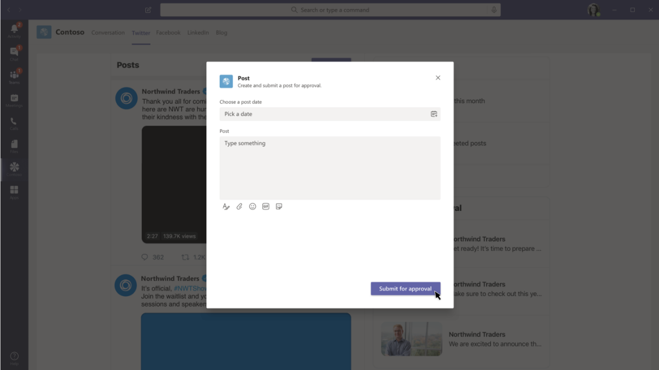
开发基于操作的消息传递扩展
操作命令允许开发人员为用户提供模式弹出窗口，以收集或显示信息。
在应用清单中注册扩展
当受到调用时，JSON 有效载荷会发送到你注册的 Web 服务中
Web 服务与作为嵌入式网络接口或自适应卡实现的任务模块相呼应
Alt：定义静态参数列表
Web 服务处理用户提交的任务模块。
Notes:
Note – invocation options:
Can be triggered from:
The command/search bar
The compose message area
From a message’s “More actions” menu
- If your messaging extension is invoked from the command box- you cannot respond with a bot message inserted directly into the conversation
- If your messaging extension is invoked from the ... overflow* menu on a message the initial invoke to your bot will include a JSON object containing the message contents, which you can process before presenting users with a task module.
You have three options for creating the form that is rendered inside the task module: - Static list of parameters - This is the simplest option. You can define a list of parameters (input fields) in your app manifest the Teams client will render. You cannot control the formatting with this option. - Adaptive card - You can choose to use an adaptive card, which provides greater control over the UI, but still limits you on the available controls and formatting options. - Embedded web view - If you need complete control over the UI and controls, you can choose to embed a custom web view in the task module.

Slide 19
演示
Microsoft Teams 中的消息传递扩展
操作指令消息传递扩展
Notes:
See the file M01_Manage roles and create teams.docx for instructions for this demonstration.​
​Demonstrations references in this deck utilize a Microsoft 365 E5 tenant and access to Microsoft Teams.
Set up instructions -Set up can take up to 60min
https://microsoft.sharepoint.com/:w:/t/FY20BaselineLocalEventsPlanning/ERs4HL_d3RNFiwERCPC3mGMBkKo0lIjdgJb_r78bpJYWyg?e=wIQtUi
​

Slide 20
搜索指令的消息传递扩展

Slide 21
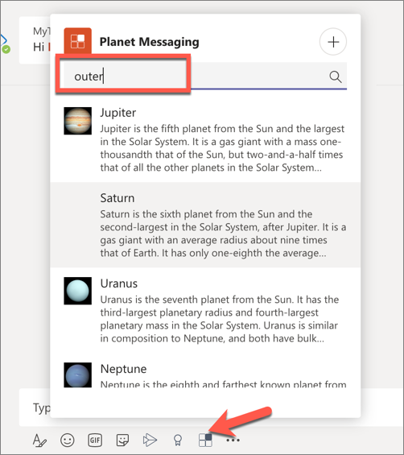
什么是搜索命令？
搜索命令使用户能够在外部系统中搜索信息。
搜索查询从 Microsoft Teams 发送到你的 Web 服务。
你的 Web 服务回应一个结果列表或网格。
当用户选择一个结果时，它将作为卡片或文本添加到编写消息框中。
Notes:
Search commands can be invoked from one or both of the following locations: - The buttons at the bottom of the compose message area
- By @mentioning your app in the command box
Unlike action commands, search commands cannot be invoked from messages.
When invoked from the compose message area, your user will have the option of sending the results to the conversation. When invoked from the command box, the user can interact with the resulting card, or copy it for use elsewhere.

Slide 22
开发基于搜索的消息传递扩展
创建基于搜索的消息传递扩展包括在应用清单中定义消息传递扩展的命令，并设置你的服务以接收和响应查询。
定义基于搜索的消息传递扩展命令
接收查询
响应查询

Slide 23
链接展开消息传递扩展

Slide 24
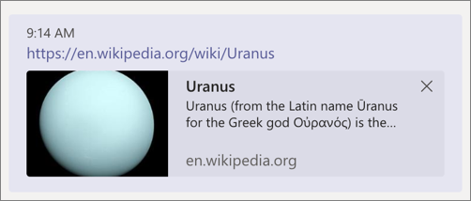
开发链接展开消息传递扩展
链接的展开允许你的应用处理粘贴在消息中的链接。
你的应用可以注册，以便在带有特定域名的 URL 被粘贴到编写消息区域时接收调用活动。
该调用将包含被粘贴到编写信息区域的完整 URL
你可以用一张用户可以展开的卡片进行回应，其中提供额外的信息或操作
Notes:
Link unfurling is the process of taking a hyperlink pasted into a message and doing some action based on the result of processing the link. This process allows you to do a search, or display a card.
Adding a link unfurling messaging extension follows a similar process as action commands and search commands.
You'll first register domain(s) supported by your messaging extension and then implement the handler in your web service.

Slide 25
创建包含选项卡的嵌入式 Web 体验
创建自定义 Microsoft Teams 个人选项卡
创建自定义 Microsoft Teams 通道或组选项卡
Notes:
Tabs are Microsoft Teams-aware webpages embedded in Microsoft Teams. They can be added as part of a channel or a group chat inside a team or as a personal app for an individual user. As part of your app, you can add custom tabs to embed your own web content in Teams.
In this section, you'll learn how to create tabs and add them to your Microsoft Teams app.

Slide 26
创建自定义 Microsoft Teams 个人选项卡

Slide 27
什么是 Microsoft Teams 中的选项卡？
Microsoft Teams 中的选项卡显示由开发人员托管的 Web 应用，在 Teams 客户端中的 IFRAME 内。
在应用清单中定义的选项卡范围：
团队（通道）：已添加到团队中的通道
群聊：可用于 2 个或更多用户之间的群聊
个人：仅可通过应用栏侧面导航提供给单个用户使用
调整现有的 Web 应用体验
从头开始建立选项卡
Notes:
Microsoft Teams determines where a tab can be used based on its scope. You set the scope in the app manifest by using one of these values:
Teams (`team` scope): Tabs in channels allow teams to interact with your shared experience. Currently, all tabs in channels are configurable tabs - a user configures the content of your tab experience when the tab is first added to a channel.
Group chat (`groupchat` scope): You can also use configurable tabs in group chats, defined as conversations between two or more users.
Personal (`personal` scope): Tabs in the personal scope allow users to interact privately with your experience. Currently, all personal tabs are static tabs - content that is relevant to individual users.
Tabs display web pages, but not all web pages render properly in a tab. Pages loaded in a custom tab need to:
- Allow Teams to display them in an iframe (via the `X-Frame-Options` and/or `Content-Security-Policy` headers). Iframes provide nested browsing hosted by the parent window (`window.parent`). Many standard webpages don't allow iframes.
- Handle authentication differently, such as using a popup. Most websites simply redirect to a login provider, which typically dead-ends tabs hosted in an iframe in order to prevent clickjacking.
- Handle cross-domain navigation differently, because the Teams client needs to validate the origin against a static `validDomains` list in the app manifest when loading or communicating with the tab.
- Use the Teams client visual themes.
- Make calls to the Teams client SDK (`microsoftTeams.initialize`()), which gives Teams a communication channel with the hosted page and more visibility into its operations.

Slide 28
浏览相同内容时，选项卡与 Web 应用不同
虽然 Microsoft Teams 选项卡是在 iframe 中显示的网页，但在 Microsoft Teams 客户端中与 Web应用的互动与仅仅浏览相同的内容相比有一些不同。
选项卡在 IFRAME 中显示 Web 内容
认证方式不同
跨域验证不同
必须列出所有可在选项卡中显示的域
Web 应用样式基于 Teams 客户端明/暗/高对比度模式
Teams 和托管页面之间的通信通过 Teams 的 JavaScript 客户端 SDK 处理
Notes:
While Microsoft Teams tabs are webpages displayed in an iframe, , there are some differences between interacting with the web app within the Microsoft Teams client compared to just browsing the same content.
Microsoft Teams tabs always display web content in an \<iframe\> where a web page is loaded in any browser. This allows you to create unique experiences with the web app for only Microsoft Teams by limiting where the application is hosted. For instance, you can limit a web page to only be displayed within an \<iframe\> from a specific domain such as teams.microsoft.com.
Authentication is handled differently in a Microsoft Teams tab compared ot a web app, either via a popup or calling Azure AD to fetch tokens. Most websites simply redirect to a login provider that typically breaks for custom tabs that are hosted inside of an \<iframe\>. Tabs break in this experience because the sign in pages typically do not load within an \<iframe\> to prevent click-jacking.
Cross-domain navigation is handled differently in tabs from a web app. The Teams client needs to validate the origin against a static validDomains list in the app manifest when loading or communicating with the tab.
Microsoft Team tabs can be styled to match the current Microsoft Teams client's theme such as default, dark or high contrast.
Developers of Microsoft Teams tabs can also communicate with the hosting Microsoft Teams client using the JavaScript SDK (microsoftTeams.initialize()). The SDK gives Teams a communication channel with the hosted page and more visibility into its operations.

Slide 29
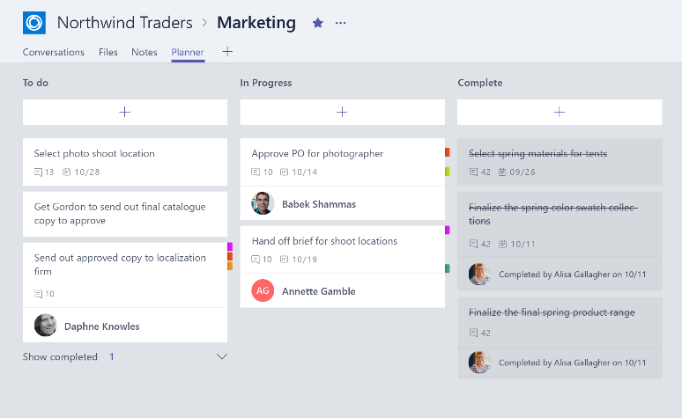
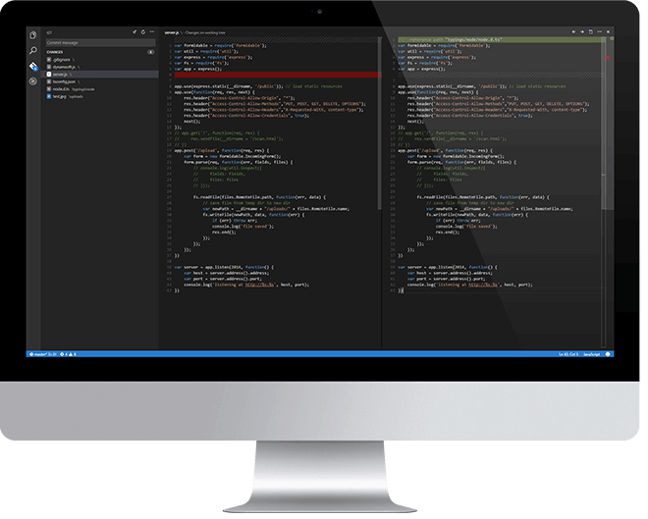
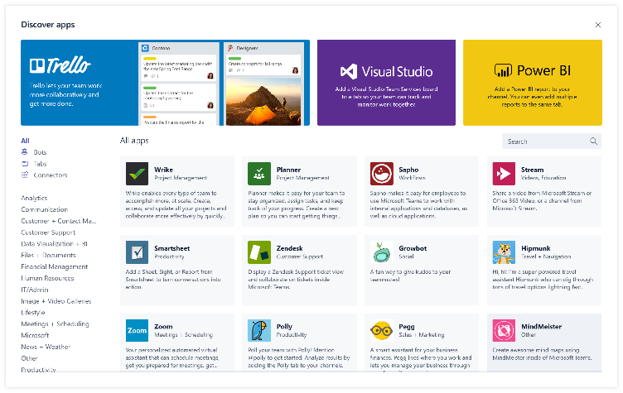
构建 Microsoft Teams 选项卡概述
设计出色的选项卡
选择相关的应用功能
用户体验的范围和重点
整合和简化访问
开发选项卡
HTML/JavaScript/TypeScript
REST 服务
深层链接和上下文
部署选项卡
上传到 Teams
上传到租户应用库
提交到 Office Store
Notes:
Let’s look at what is involved in building a Microsoft Teams tab.
Microsoft has design guidelines for creating custom tabs that include the following:
Focus on functionality: Tabs work best when they’re built to address a specific need. Focus on a small set of tasks or a subset of data that’s relevant to the channel the tab is in.
Reduced chrome: Avoid creating multiple panels in a tab, adding layers of navigation, or requiring users to scroll both vertically and horizontally in one tab. In other words, try not to have tabs in your tab.
Integration: Find ways to notify users about tab activity. For example, post message card to a conversation about tab activity.
Conversational: Find a way to facilitate conversation around a tab. This ensures that conversations center on the content, data, or process at hand.
Streamlined access: Make sure you're granting access to the right people at the right time. Keeping your sign in process simple will avoid creating barriers to contribution and collaboration.
Once you've designed a great Microsoft Teams tab, the next step is to develop it. Tabs are just web apps hosted in an \<iframe\> within the Microsoft Teams client. Developers are free to use any web technologies and frameworks they are most comfortable with to implement the custom tab experience, such as HTML, JavaScript, TypeScript, web frameworks such as React or Angular, and server-side technologies.
The last step is to deploy the custom tab. Unlike other Microsoft Teams extensibility options such as bots and message extensions, developers can upload custom tabs directly to a team. Microsoft Teams apps can also be uploaded your tenant’s app gallery for other users to install in their teams.

Slide 30
演示
Microsoft Teams 中的选项卡
创建自定义 Microsoft Teams 个人选项卡
Notes:
See the file M01_Manage roles and create teams.docx for instructions for this demonstration.​
​Demonstrations references in this deck utilize a Microsoft 365 E5 tenant and access to Microsoft Teams.
Set up instructions -Set up can take up to 60min
https://microsoft.sharepoint.com/:w:/t/FY20BaselineLocalEventsPlanning/ERs4HL_d3RNFiwERCPC3mGMBkKo0lIjdgJb_r78bpJYWyg?e=wIQtUi
​

Slide 31
创建自定义 Microsoft Teams 通道或组选项卡

Slide 32
比较个人和通道选项卡
个人标记
以前称为静态选项卡
范围 = 个人
支持个人用户
不打算与团队中的其他人共享
显示清单中设置的网页
通道选项卡
以前称为可配置选项卡
添加到通道
范围 = 团队
作为两个或更多用户之间聊天的一部分添加
范围 = 群聊
支持一个团队/通道的所有成员
显示在配置页中设置的网页（内容页）
Notes:
The primary difference between channel tabs and personal tabs is that channel tabs display a configuration experience to the user adding the tab to a channel. You as the developer can use this configuration page to collect any information needed for the web app to display the tab.

Slide 33
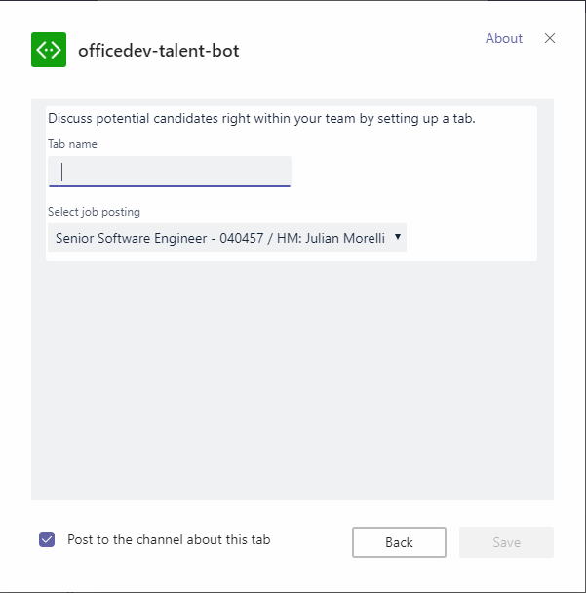
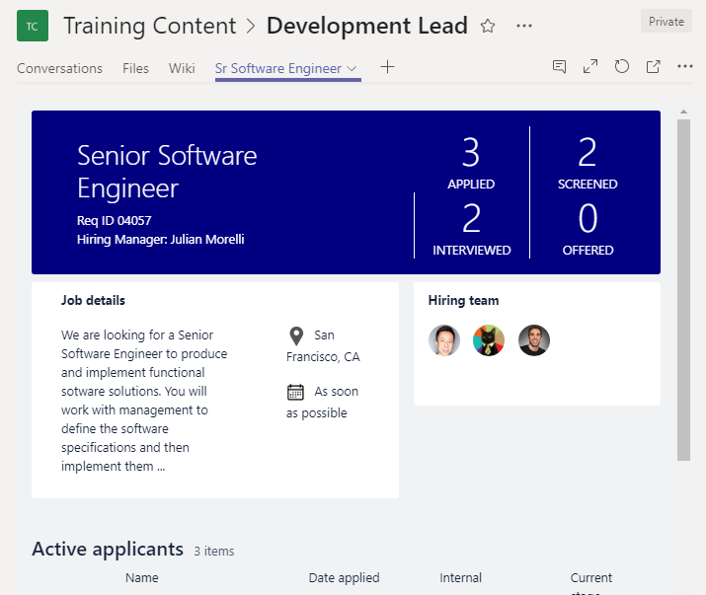
选项卡配置和内容
选项卡配置
已在清单中配置
当选项卡添加到通道时显示
显示应用清单中指定的网页
收集信息
调用指定 ContentUrl 和实体 ID 的 setSettings()
选项卡内容
在 IFRAME 中渲染
由配置页或清单指定的内容 URL
检查 EntityId / SubEntityId 的上下文
根据 Entity / SubEntity / User 检索状态
Notes:
Creating a channel tab involves the following: create the configuration page and create the content page
Create the configuration page: For channel and group tabs, you must provide a configuration page to present options and gather information so users can customize the content in, and experience with, your tab. You can also enable users to update or remove a tab after they add it
For example, consider a channel tab that displays the contents of a SharePoint list. The configuration page can collect the SharePoint site and list from the user and use that information to retrieve and display the correct list data in the tab.
The configuration page is another web app that the developer must create. The Microsoft Teams SDK allows developers to attach to an event fired when the user saves the configuration information. You're responsible for saving any configuration information your tab will need.
Developers can set the tab’s `contentUrl` and `entityId` from this save method, based on the options specified in the configuration page.
Create the content page: A content page is an HTML page that you host. You can also provide a page for users to specify what happens to content when they remove a tab
Similar to a personal tab, the content displayed in a channel tab is displayed in an \<iframe\>. The URL loaded in the \<iframe\> is defined by the `contentUrl` specified in the configuration page. The web app can then use the Microsoft Teams JavaScript SDK to obtain the `entityId` and/or `subEntityId` to determine the content to display. These properties can be used to implement tab-to-tab communication using deep linking.

Slide 34
为 Microsoft Teams 创建交互式对话机器人
Microsoft Teams 中的机器人概述
Microsoft Teams 通道和群聊中的机器人
来自机器人的主动消息
Notes:
Conversational bots allow users to interact with your web service through text, interactive cards, and task modules. Conversational bots can be scoped to handling a few simple commands or complex, artificial intelligence powered and natural language processing virtual assistants. They can be one aspect of a larger application, or completely stand alone.
In this section, you’ll learn how to create and add bots to custom Microsoft Teams apps.

Slide 35
Microsoft Teams 中的机器人概述

Slide 36
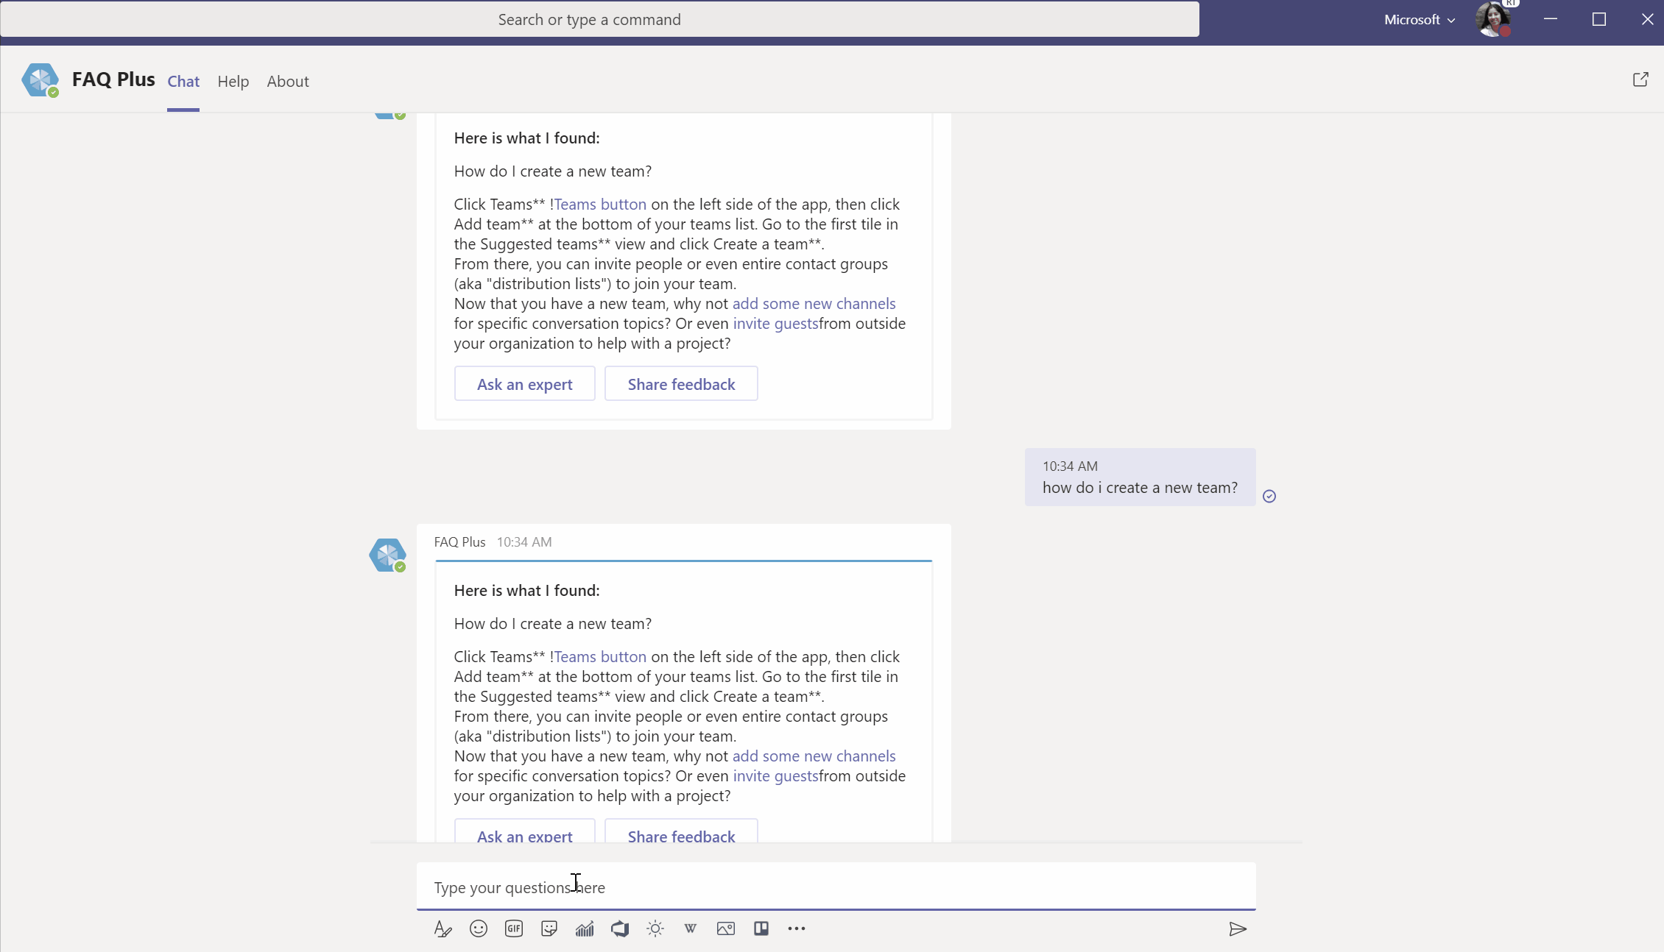
Teams 中的机器人概述
机器人是用户以对话方式与之互动的 应用
用户可以输入文本或图形或使用语音
用户和机器人之间的每一次互动 都会产生一个活动对象
Bot Framework Service 在用户通道和机器人之间发送活动对象

Slide 37
机器人最好处理哪些任务？
Teams 应用中的对话机器人允许用户通过文本、互动卡片和任务模块与 Web 服务互动
对话类型：
在通道中：多人之间的线程对话
个人互动需要简洁明了；限制多轮互动
机器人可以访问直接 @ 提及它们的对话
非常适合通知、投票/调查以及具有单一请求/响应周期的互动
在群聊中：三个或更多人之间的非线程对话
机器人可以访问直接 @ 提及它们的对话
适用于类似通道机器人的场景
在一对一聊天中：与单个用户的交互
多种场景：问答、记笔记、在其他系统中启动工作流的机器人等。
Notes:
Each scope provides unique opportunities, and challenges, for your conversational bot.
Always consider whether a conversation-based interface is the best way to present your functionality.

Slide 38
为 Microsoft Teams 开发对话机器人
为 Microsoft Teams 创建对话机器人需要进行以下操作：
自定义 web 服务
使用 Microsoft Bot Framework 将 Web 服务注册为机器人
创建 Microsoft Teams 应用清单和应用包
将应用包上传到 Microsoft Teams
Notes:
Microsoft provides SDKs for multiple platforms, including .NET and Node.js. The exercises in this course will use the Node.js SDK

Slide 39
机器人对话基本原理
消息内容
活动对象类型messageType：消息
接收消息
使用活动对象的文本
发送消息
指定你要作为活动发送的字符串。 使用 Turn 上下文对象的 SendActivity() 方法发送单个消息响应。
Notes:
Each message is an Activity object of type messageType: message. When a user sends a message, Teams posts the message to your bot; specifically, it sends a JSON object to your bot's messaging endpoint. Your bot examines the message to determine its type and respond correctly.
To receive a text message, use the text property of the Activity object. In the bot's activity handler, use the turn context object's Activity to read a single message request.
To send a text message, specify the string you want to send as the activity. In the bot's activity handlers, use the turn context object's SendActivity() method to send a single message response.

Slide 40
演示
Microsoft Teams 中的对话机器人
为 Microsoft Teams 创建对话机器人
Notes:
See the file M01_Manage roles and create teams.docx for instructions for this demonstration.​
​Demonstrations references in this deck utilize a Microsoft 365 E5 tenant and access to Microsoft Teams.
Set up instructions -Set up can take up to 60min
https://microsoft.sharepoint.com/:w:/t/FY20BaselineLocalEventsPlanning/ERs4HL_d3RNFiwERCPC3mGMBkKo0lIjdgJb_r78bpJYWyg?e=wIQtUi
​

Slide 41
Microsoft Teams 通道和群聊中的机器人

Slide 42
Microsoft Teams 中的对话机器人
Microsoft Teams 会向你的机器人发送通知，通知你的机器人活动范围内发生的事件。
示例场景：
当你的机器人被添加到团队中时，触发欢迎消息
在添加或删除新团队成员时触发欢迎消息
在创建/重命名/删除通道时触发通知
当机器人的某一条消息得到用户点赞时
TypeScript
export class ConvoBot extends TeamsActivityHandler { constructor() { super(); this.onReactionsAdded(async (context: TurnContext, next: () => Promise<void>) => { if (context.activity.reactionsAdded) { context.activity.reactionsAdded.forEach(async (reaction) => { if (reaction.type === 'like') { await context.sendActivity(`Thank you!`); } }); } await next(); }); } }
Notes:
Microsoft Teams sends notifications to your bot for events that happen in scopes where your bot is active. You can capture these events in your code and take action on them.
For example, your bot can handle instances where a user has reacted to one of your bot's messages. This is done by monitoring the events reactionsAdded or reactionsRemoved (slide code sample)

Slide 43
与 Microsoft Teams 的机器人进行通道和群组聊天对话
通过向你的机器人添加团队或群聊范围，它可以安装在团队或群聊中。 这允许对话的所有成员通过 @提及你的机器人来与其互动。
与 @提及的人合作
确保你的消息解析处理 @<botname> 在消息中提到的消息文本。
你的机器人可以检索消息中提到的其他用户，并将提到的消息添加到它发送的消息中
必要时从消息文本中剥离提及的内容
检索提及
提及的内容会在有效载荷的实体对象中返回。 使用此内容检索关于用户的信息。
既包含用户的唯一 ID，通常也包含所提及用户的名字
消息文本将包括提及：<at> @John Smith<at>
Notes:
By adding the teams or group chat scope to your bot, it can be available to be installed in a team or group chat. This allows all members of the conversation to interact with your bot.
Once installed, it will also have access to metadata about the conversation like the list of conversation members, and when installed in a team details about that team and the full list of channels.
Note The bot must be @mentioned directly. Your bot won't receive a message when the team or channel is mentioned, or when someone replies to a message from your bot without @mentioning it.

Slide 44
来自机器人的主动消息

Slide 45
主动消息
主动消息是指机器人在通道中创建新消息。
可能的场景：
个人机器人对话的欢迎信息
投票响应
外部事件通知
仔细考虑何时使用主动消息
Notes:
Sending proactive messages to users can be an effective way to communicate with your users. However, from their perspective this message can appear to come to them completely unprompted.
Considerations for each scenario:
Welcome messages: When you use proactive messages to send a welcome message to users, you must keep in mind that for most people receiving the message they'll have no context for why they're receiving it.
Notifications: When you use proactive messages to send notifications, you need to make sure your users have a clear path to take common actions based on your notification, and a clear understanding of why the notification occurred.

Slide 46
用任务模块收集输入
用任务模块收集用户输入
在任务模块中使用自适应卡片和深度链接
与机器人一起使用任务模块
Notes:
Task modules are modals that you can populate with either an Adaptive Card or an embedded web/content page for use in your custom Microsoft Teams app’s user experience for workflows that require data input. Task modules allow you to gather information in a Teams-aware popup.
In this section, you'll learn how to create and add task modules to your Microsoft Teams app.

Slide 47
用任务模块收集用户输入

Slide 48
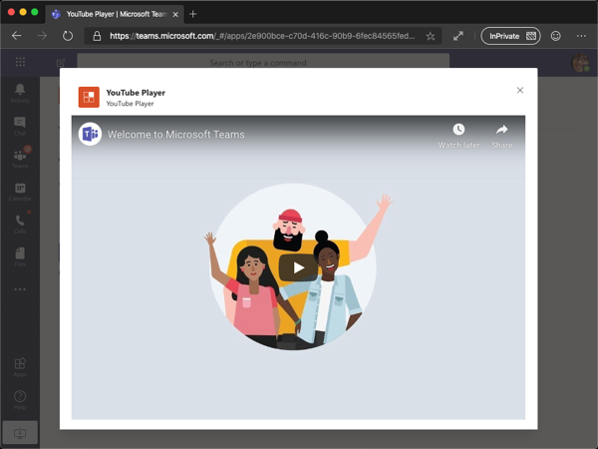
什么是任务模块？
任务模块在 Microsoft Teams 中提供了模式弹出窗口体验。
收集用户输入的理想体验
可以将多个输入连锁在一起，创造向导式体验
建立在 Teams 选项卡的基础上 - 只是一个弹出窗口中的选项卡
可以作为网页或自适应卡实现
Notes:
Task modules allow you to create modal popup experiences in your Teams application.
Inside the popup you can run your own custom HTML/JavaScript code, show an <iframe>-based widget such as a YouTube or Microsoft Stream video or display an Adaptive Card.
They're especially useful for starting and completing tasks or displaying rich information like videos or Power BI dashboards. A popup experience is often more natural for users starting and completing tasks compared to a tab or a conversation-based bot experience.
Task modules build on the foundation of Microsoft Teams tabs; they're essentially a tab inside a popup window. They use the same SDK, so if you've built a tab you're already 90% of the way to creating a task module.

Slide 49
任务模块结构
应用图标
应用简称
任务模块的标题
关闭/取消按钮
整个区域可用于网页选项
如果使用自适应卡选项，就会渲染整个区域
自适应卡按钮

Slide 50
任务模块回调和调用错误
在使用 startTask() 调用任务模块时，你可以指定 submitHandler 回调：
submitHandler(error: string, result: string | any)
回调接收结果的形式可以是字符串（来自网页）或对象（网页/自适应卡）
如果一个错误对象被传递给回调，它将是以下值之一：
"Values for both card and url were specified. One or the other, but not both, are allowed."：taskInfo 对象包含 url 和 card 两个属性的值。 二者互斥，应只指定一个。
"You must specify a value for either card or url."：这个错误与前一个错误相反。 url 或 card 属性均为必填。
"Invalid appId."：taskInfo.appId 属性无效。
"User cancelled/closed the task module."：用户关闭了任务模块。
Notes:
If an error object is passed to the callback, it will be one of the following values:
"Values for both card and url were specified. One or the other, but not both, are allowed.": The taskInfo object contains values for both the url and card property. These are mutually exclusive and only one should be specified.
"You must specify a value for either card or url.": This error is the inverse of the previous one. Either the url or card properties are required.
"Invalid appId.": The taskInfo.appId property isn't valid.
"User cancelled/closed the task module.": The user closed the task module.

Slide 51
演示
Microsoft Teams 中的任务模块
用任务模块收集用户输入
Notes:
See the file M01_Manage roles and create teams.docx for instructions for this demonstration.​
​Demonstrations references in this deck utilize a Microsoft 365 E5 tenant and access to Microsoft Teams.
Set up instructions -Set up can take up to 60min
https://microsoft.sharepoint.com/:w:/t/FY20BaselineLocalEventsPlanning/ERs4HL_d3RNFiwERCPC3mGMBkKo0lIjdgJb_r78bpJYWyg?e=wIQtUi
​

Slide 52
在任务模块中使用自适应卡片和深度链接

Slide 53
用深度链接调用任务模块
深度链接是特殊的 URL，包含 Microsoft Teams 用来调用任务模块的特定值。
深度链接可用于从 Microsoft Teams 内部或外部调用任务模块。
HTTP
https://teams.microsoft.com/l/task/<APP_ID>?url=<TASKINFO.URL>&height=<TASKINFO.HEIGHT>&width=<TASKINFO.WIDTH>&title=<TASKINFO.TITLE>
Notes:
Can be used to invoke the task module from within Microsoft Teams (conversations, links in tabs, etc.) or outside of Microsoft Teams
Include the Microsoft Teams app’s unique ID in the URL, and all necessary properties for the task module project
Deep link values:
<APP_ID>: This is the ID of the custom Microsoft Teams app. The app ID, a GUID, can be found in the app's manifest.json file.
<TASKINFO.*>: The additional properties in the query string of the URL map to specific properties on the taskInfo object covered earlier..
The deep link can be used from anywhere, including the conversations within Microsoft Teams channels or in external applications.

Slide 54
与机器人一起使用任务模块

Slide 55
任务模块和机器人
机器人可以调用和处理来自任务模块的提交
机器人与选项卡和深度链接不同：
没有用户界面可供用户操作以触发打开任务模块
机器人在 Microsoft Teams 外部的服务中运行
Microsoft 的 Bot Framework 和 Microsoft Teams SDK 已经增加了对以下操作的支持
调用任务模块
处理 Action.Submit 事件，即任务模块向机器人提交信息的事件
机器人可以通过以下两种方式之一调用任务模块：
创建深度链接，并将其嵌入用户可以选择的消息中
回复/发送特殊类型的消息给 Bot Framework 和 Microsoft Teams
Notes:
Task modules offer developers a way to collect user input with a bot and keep everyone in the channel from seeing what another user is doing with the bot.
Invoking a task module from a bot:
Recall from earlier, the process of invoking a task module is to call the submitTask(taskInfo, submitHandler) method in the Microsoft Teams JavaScript SDK. This method won't work when invoking the task module from the bot because the bot's code is running as a web service external to Microsoft Teams.

Slide 56
调用消息回调响应
指示显示消息或其他任务模块：
JSON
JSON
JSON
{
"task": {
"type": "message",
"value": "Message text
}
}
{
"task": {
"type": "continue",
"value": {
"title": <TaskModuleTaskInfo object>
}
}
}
Notes:
Both invoke message handlers return an object of type TaskModuleResponse

